Slide 1

Lcovid-19 waves BMD-303 Project

Slide 2
Table of contents
01
Introduction
02
Problem definition & Purpose
03
04
Results & Conclusion
Methodology
05
References

Slide 3
Introduction
We have depended on NCBI Covid-19 Database to extract the needed data.
using the multi-sequence alignment.
Used 20 samples with different Lineages.
In this project we were working on data generated by NGS sequence for a Covid-19 virus at different times in the US between Jan 2021 to May 2022, and compare between the covid sequence in these different waves. Additionally, we've applied the pairwise alignment between Covid-19 Spike protein with other Viral spike proteins.
Generating the phylogenetic tree with its visualization.
Blast alignment to align the spike protein with other viral proteins.
Analysis of the followed steps by the Bash Script.

Slide 4

Problem definition & Purpose
In December 2019 in China Wuhan city, a new very speed virus appeared with a title COVID-19, then the disease spread until it became a pandemic and million of people got infected by it, and many countries went through different waves of COVID-19, and each wave is slightly different in its symptoms a cluster of patients with pneumonia of unknown cause was linked to a seafood wholesale market in Wuhan, China.
The disease is a highly contagious respiratory disease caused by the SARS-CoV-2 virus. SARS-CoV-2 is thought to spread from person to person through droplets released when an infected person coughs, sneezes, or talks. It may also be spread by touching a surface with the virus on it and then touching one’s mouth, nose, or eyes.

Slide 5
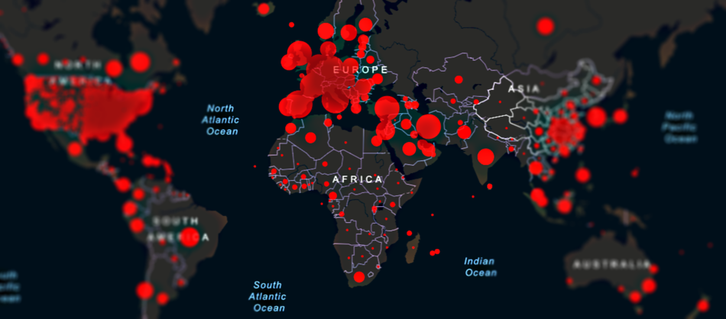
Spread of the COVID-19

Slide 6
—The main purpose of thde project
To discover the common and difference in the RNA sequence of covid-19 through the different waves of covid, and to analyse which sequence is more .
Identify the most homologs type of viral spike proteins with the covid spike protein.

Slide 7
Methodology
Data Gathering
Blast
Phylogenetic tree
Annotation
Bash Script
1
2
3
4
5
Extract the data from NCBICovid-19 “USA” 10 samples.
Multi seq alignment to compare the RNA of covid in different waves, to know how the changes and when happen.
Comparison between covid-19 spike protein and other viral spike proteins to get the most homologs.
Get more information about the spike protein we have.
Deliver all analysis steps into Bash script.

Slide 8
Methodology
Data Gathering
Phylogenetic Tree
Extracting the data from "NCBI Covid-19" and have chosen to work on the timeline of waves for the same country "United States" within different times using "10 samples" with different Lineage with "Fasta format", then converted into note bad. Used these downloaded data on the "Muscle Alignment" in order to generate "Phylogenetic Tree".
Prepare the sequence in one file to apply the multiple sequence alignment to compare all the RNAs in covid-19 virus through the different waves and generate the phylogenetic tree to identify the development and the division of the virus with its new versions within the waves and detect the time that took for these changes.

Slide 9
Methodology
Blast & Annotation
Bash Script
We worked on the spike protein that we have with the database to find the most homologs spike and get its information.
We created a for loop to make a pairwise alignment along the database we use through using Blast.
Blash.sh
By using bash scripting tool, we performed multiple sequence alignment for our retrieved samples. Then, we generated a phylogenetic tree and visualized it.

Slide 10
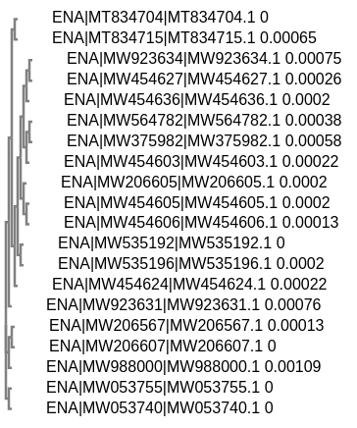
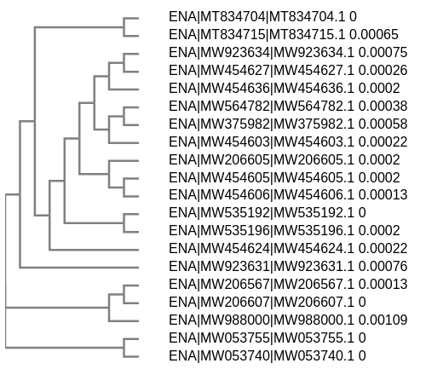
Phylogenetic tree
Results & Conclusion

Slide 11
Results & Conclusion
After we divided each blast file separately against the database, we were able to identify the gene that is most likely to result in recombination by performing the significant homologous search step. This step involves the alignment of two homologous sequences and the identification of the homologous site. So, we have chosen our most homologous gene based on the criteria of E-value, bit score, and the best coverage of each file.
Our best sequence for:
KT182953.1 Middle East respiratory syndrome coronavirus
After we used Uniport to mention in detail the function of the protein, gene ontology, cellular and molecular function and how it affects the disease.

Slide 12
Results & Conclusion
In order to be able to compare BLAST results done by using different matrices and gap penalties, we used:
As Bit Score (S’), as it’s considered a more reliable principle for assuming homology is the bit-score, an average bit score of 50 indicates that a protein is almost always significant.
E-value: for sequence matches to the query that are related to chance rather than homology are more likely to be found in larger databases.
For homology matches, blast hits with an E-value less than 0.01 can still be considered good hits. E-values below 10 will include hits that cannot be considered relevant but may provide a suggestion as to possible relationships.

Slide 13
Results & Conclusion
Molecular Function
Spike protein S1: connects the virion to the cell film by collaborating with have receptor, starting the disease.
Spike protein S2': Goes about as a viral combination peptide which is exposed following S2 cleavage happening upon infection endocytosis.
Spike protein S2: intervenes combination of the virion and cell films by going about as a class I viral combination protein. Under the ongoing model, the protein has no less than three conformational states: pre-combination local state, pre-barrette halfway state, and post-combination fastener state.
Cellular Function
Host cell membrane Viral envelope protein Virion
Host Membrane Virion
Membrane

Slide 14
Reference
I. Khan, A. Haleem, and M. Javaid, “Analysing COVID-19 pandemic through cases, deaths, and recoveries,” Journal of Oral Biology and Craniofacial Research, vol. 10, no. 4, pp. 450–469, 2020
S. A. Shams, A. Haleem, and M. Javaid, “Analyzing COVID19 pandemic for unequal distribution of tests, identified cases, deaths, and fatality rates in the top 18 countries,” Diabetes & Metabolic Syndrome: Clinical Research & Reviews, vol. 14, no. 5, pp. 953–961, 2020
S. Samadizadeh, M. Masoudi, M. Rastegar, V. Salimi, M. B. Shahbaz, and A. Tahamtan, “COVID-19: why does disease severity vary among individuals?,” Respiratory Medicine, vol. 180, Article ID 106356, 2021.
] R. Forman, S. Shah, P. Jeurissen, M. Jit, and E. Mossialos, “COVID-19 vaccine challenges: what have we learned so far and what remains to be done?,” Health Policy, vol. 125, no. 5, pp. 553–567, 2021.
V. Parcha, K. S. Booker, R. Kalra et al., “A retrospective cohort study of 12,306 pediatric COVID-19 patients in the United States,” Scientific Reports, vol. 11, no. 1, p. 10231, 2021.

Slide 15
This work done by:
Manar Abdelrehim
Shrouk Hesham
Omnia Salah
Hussin Fekry
Seifelden Mohamed
Abdulrhman Mahmoud

Slide 16
Under Supervision of:
Dr. Mohamed El Hadidi
Eng. Manar Rashed
Eng. Eman Abdelrazik

Slide 17
Thanks, any Questions?

